Slide 1

September 2022
The new academic year
Information for parents and pupils
- BELIEVE - INSPIRE - ACHIEVE -

Slide 2
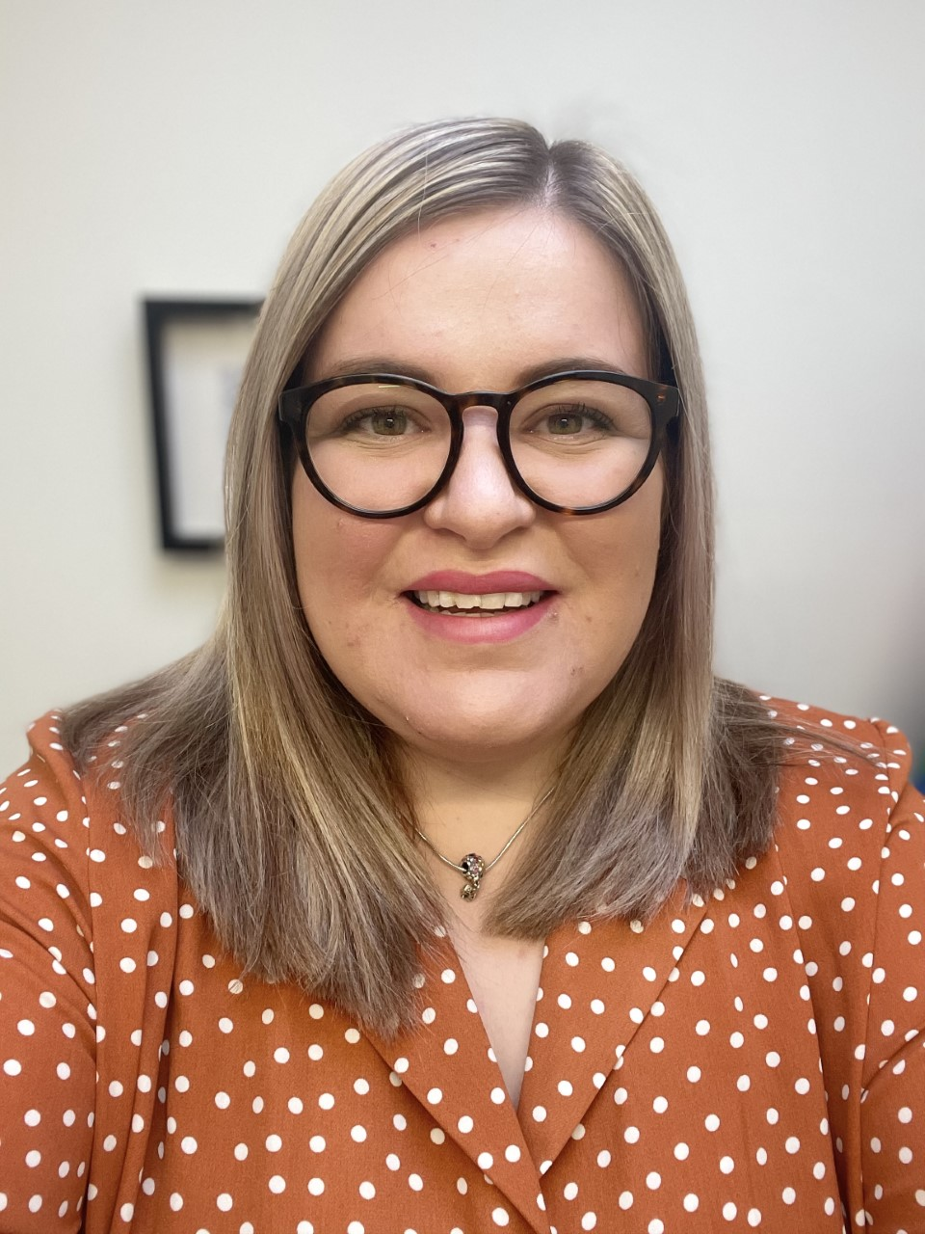

Looking ahead to September:
Another school year is drawing to a close and what a busy –but what a successful- year it has been! It continues to be a great pleasure to lead our school on its improvement journey and I am excited for the new academic year ahead.
As a busy working mum myself, I know how important it is to get ahead with preparations for the new academic year. From preparing our children for their new class/teacher, to ordering uniform and other school essentials, to plotting out key diary dates… this information pack has been designed to support you with all of these tasks.
We look forward to working alongside you in the coming year; celebrating your child’s successes and championing them every step of the way!
Mrs L Middleton
Head of School
Our ‘core values’
The following three words underpin our hopes and aims for all pupils: BELIEVE—INSPIRE—ACHIEVE
At Sutton Park Primary School, we strongly believe that every child matters. We respect each child in our school for who they are, and we treat them with fairness and honesty.
We provide our pupils with a creative and engaging curriculum that will ensure they have the knowledge and skills they need to set them on the path to becoming lifelong learners.
It is an expectation that in every year group we will provide our children with learning experiences that will enable them to excel in their academic, emotional and social life.
Representation, equality and diversity underpin our curriculum offer. Everyone is welcome in our school; valued for who they are; respected for their beliefs and for their differing cultural heritage.
We have high aspirations for every pupil we serve; we will prepare them for life beyond our school, ensuring they can be a successful as possible in their future endeavours.
It is our hope that our curriculum will pave the way for further education; igniting a love for learning and promoting the huge life-value which education provides.

Slide 3
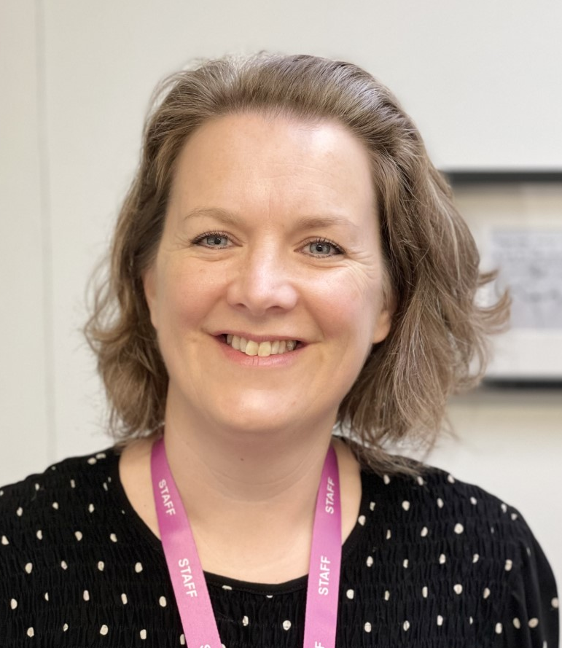
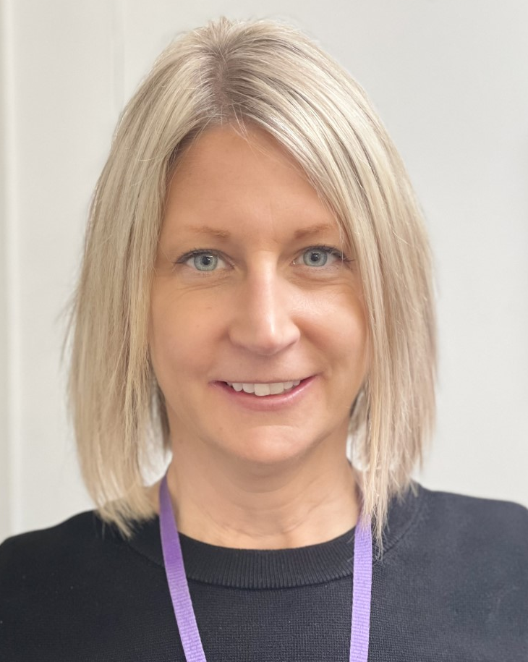
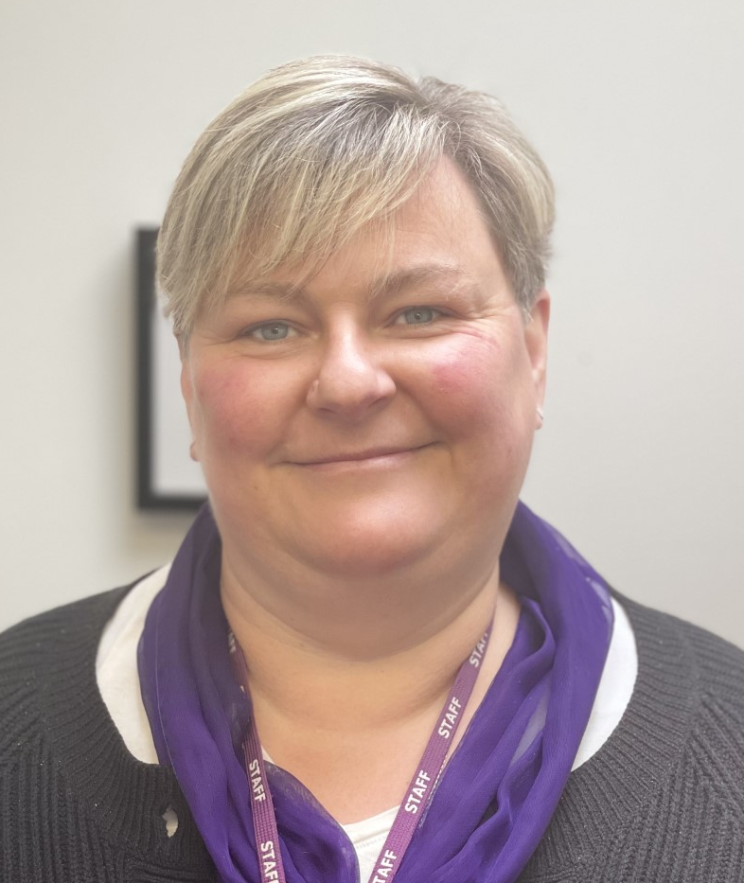
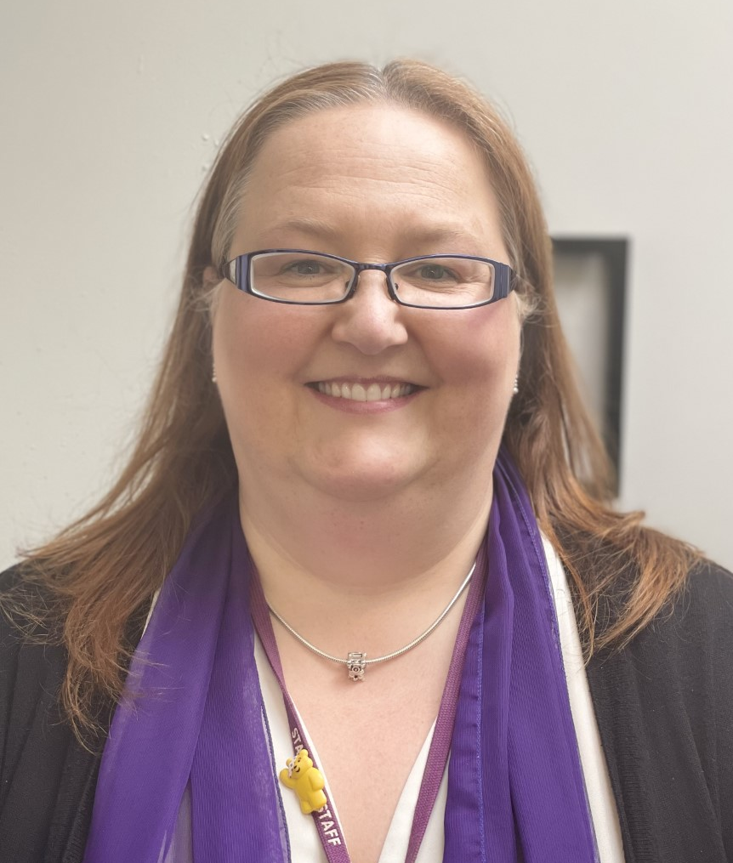
Our staff:
We are lucky to have a fantastic team of staff at Sutton Park Primary. There are several departments and teams who work within school, including: Senior leaders, Pastoral team, Sports team, Teachers, Teaching Assistants, Site and Office support.
Below are some photographs of staff who you are likely to meet and encounter irrespective of which year group your child is in.
Senior leaders are on gate duty every morning and afternoon during drop off and collection. If you have any queries, please just ask.
Mrs Middleton,
Head of School
Mrs Dunning,
Deputy Head Teacher
Mrs Runacus,
Lead Practitioner
for Inclusion
Mrs Davis,
Office Manager
Mrs Johnson,
Acting Office Manager / Receptionist
- BELIEVE - INSPIRE - ACHIEVE -

Slide 4
Our staff:
Below is a copy of our full teaching & learning staffing list for September 2022.
YEAR GROUP: | TEACHING STAFF:
Nurture Group: | Miss Khan
Nursery: | Mrs Nicholson
Reception: (2 classes) | Mrs Jones & Mrs Stanley Mrs Murphy
Year 1: (2 classes) | Miss Painting Mrs Davis
Year 2: (2 classes) | Mr Pugh Miss Nock
Year 3: (1 class) | Mrs Clarke
Year 4: (1 class) | Mr Guyan
Year 5: (2 classes) | Mrs Walker-Shelton Mx Özun
Year 6: (2 classes) | Miss Trowman Miss Dhillon
Additional teaching staff: (e.g. intervention teaching, target group teaching) | Mrs Gulzar Mrs Msanide-Brookes Miss Abdalla (AHT) Mrs Davin (AHT) Mrs Kamran (AHT) Miss Simpson (AHT)
SUPPORT STAFF: | YEAR GROUP / ROLE:
Mr Murphy Mrs Macfarlane Mr Blackburn | EYFS practitioners
Mr Westwood | Y1 Teaching Assistant/Intervention
Mrs Milbourne | Y2 Teaching Assistant/Intervention
Mrs Southall | Y3 Teaching Assistant/Intervention
Mrs Langley | Y4 Teaching Assistant/Intervention
Miss Gudgin Mrs Owen Mrs Patel Miss Zalmai | Inclusion support
Mr Tonn Miss Teer | Learning Mentor Pastoral support
Miss Trowman Mr Steadman-Smith Mr Lahka-Roydes | Sports apprentices
Our Senior Leadership Team are responsible for provision in school and school improvement. They are listed below, alongside the roles they fulfil.
SLT Name: | Role:
Mrs Middleton | Head of School Designated Safeguarding Lead
Mrs Dunning | Deputy Head Teacher Y6 & Assessment Lead
Mrs Runacus | Lead Practitioner for Inclusion
Mrs Davin | Assistant Head Teacher Y1 Lead & Maths Lead
Mrs Kamran | Assistant Head Teacher Y3 Lead & Science Lead
Miss Simpson | Assistant Head Teacher Y2 and Y4 Lead, Reading Lead
Miss Abdalla | Assistant Head Teacher Y5 and Y6 Lead, Writing Lead
Miss Akay | Trust Leader for Pastoral Behaviour, Safeguarding and Attendance Lead
- BELIEVE - INSPIRE - ACHIEVE -

Slide 5
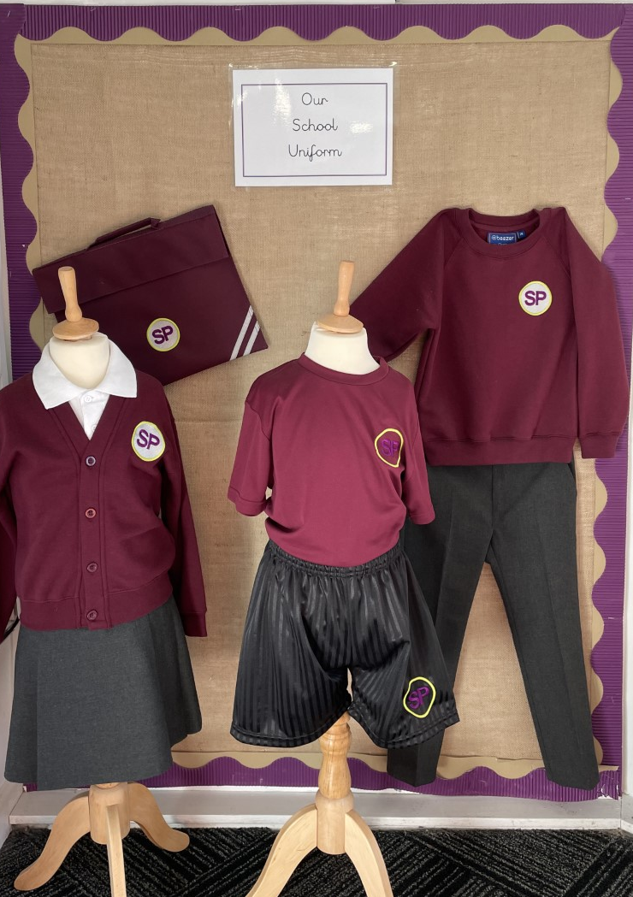
Our uniform:
Uniform is an important part of our school identity. We want our pupils to wear it with pride and to understand that it represents that they are valued members of a special community.
The compulsory uniform for Sutton Park Primary is:
Sutton Park Primary sweatshirt/cardigan (SP logo preferred)
White polo shirt (SP logo embroidered is preferred)
Grey trousers/skirt/pinafore
Grey tights/socks
Black school shoes (no trainers)
For PE, the compulsory uniform is:
Burgundy sports t-shirt (SP logo)
Black shorts (shorts with SP logo are available and preferred)
Black PE pumps/trainers for outdoors
Plain black tracksuits can also be worn.
NB: Children wear their PE kits all day on their timetabled PE days. These will be shared by your child’s class teacher in September.
There is no expectation from school for parents to provide stationery items for their child.
School will provide pens, pencils, rulers, glue sticks etc. to every child in September.
You can find further information about how to order school uniform on our website. It can be ordered here: https://www.schoolwearsolutions.com/product-category/our-schools/sutton-park-primary-school/
- BELIEVE - INSPIRE - ACHIEVE -

Slide 6


Starting school:
September 2022:
Monday 5th and Tuesday 6th September – Teacher training days
Wednesday 7th September – School begins for all pupils from Reception-Y6
Arrival and Departure Procedures:
The doors to school open at 8:45am and we operate a 10-minute window for children to get into school each morning.
Registration begins at 8:55am and any child who is not in the classroom by this time, is late.
Lates must enter school via the main school reception to receive their mark.
The school day ends at 15:15pm.
Children should be dropped off and collected from their House playground (Rowling, Lewis or Dahl, see next page) If your child in is Nursery or Reception, they are dropped off at the EYFS gate, adjacent to the main school field.
Lunchtimes:
Our kitchen team provide delicious, nutritious hot meals every day. These are automatically free to any child in Reception, Y1 or Y2 as part of the universal free school meals initiative from the government.
Other children may also be eligible for a free school meal, as part of the pupil premium free school meals offer. If you think this applies to you, please contact our school office via enquiry@suttonparkprimary.co.uk for more information.
Dinners can be purchased at a cost of £2.25 per day (payable via ParentPay) Healthy packed lunches are also permitted for all pupils who do not wish to have a hot school dinner.
Snack time:
Children in Years 1-6 are permitted to bring a healthy snack, such as fruit or a cereal bar, with them to school each day. We are a NUT-FREE school so no products containing nuts can be brought into school.
Pupils should also bring a water bottle – they have access to
fresh, filtered water freely across the school day in all year groups.
THE GOVERNMENT ARE ENFORCING INCREASED SANCTIONS FOR POOR ATTENDANCE AND PUNCTUALITY FROM SEPTEMBER.
IT IS VITAL THAT CHILDREN ARE IN SCHOOL (AND ON TIME) EVERYDAY.
- BELIEVE - INSPIRE - ACHIEVE -

Slide 7







Houses:
From September, classes will continue to be on House corridors and there will be increased opportunities for classes to play and learn together. Now that Covid restrictions have ended, there will also be ample opportunity for classes within the same year group to mix.
Each House corridor, entrance and playground will remain the same as this academic year. There are 3 houses in total across school.
The table below shows the Houses and the classes they contain:
5WS – Mrs Walker Shelton 3C –Mrs Clarke 2N – Miss Nock | 6T – Miss Trowman Nurture Group – Miss Khan 2P – Mr Pugh 5O- Mx Ozen | 1P – Miss Painting 1D – Mrs Davis 4G – Mr Guyan 6D – Miss Dhillon
Closest school entrance: George Frederick Rd | Closest school entrance: Coppice View Road | Closest school entrance: Coppice View Road
Houses form an important part of our rewards system. Children work individually and collectively to earn as many house points as they can across the school week.
Totals are shared in our celebration assemblies and special, half-termly rewards are planned for the winning house.
Behaviour
We encourage children to behave in a sociable and mindful way through positive encouragement.
We have rules in school that are for the children’s safety and well- being.
Children are encouraged to understand the necessity of rules.
We have high expectations at Sutton Park Primary and unacceptable behaviour is always recorded and reported to parents.
Should there be any concerns about your child’s behaviour we will inform you at an early stage. We always work co-operatively with parents to identify the reasons and plan positively to help your child overcome them.
Children’s positive behaviours are celebrated in many ways including:
House points
Star of the week awards
Celebration assemblies
Positive praise postcards
Headteacher awards
Annual prize-giving ceremony
- BELIEVE - INSPIRE - ACHIEVE -

Slide 8
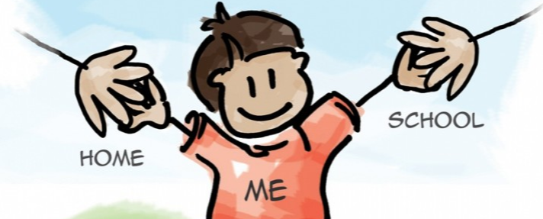

Working with parents:
No one knows your child better than you!
Our parent-partnership is an integral part of school life.
We pride ourselves on being available to listen to any queries, concerns or important information you need to share.
Our pastoral and inclusion teams are also on hand to provide advice, support and a listening ear when one is needed.
Parent and School Communication
As a trust, effective communication with our school communities is extremely important to us. From time to time we know that you may have queries or questions that you need to raise with school staff or the senior team. We understand that it is important for you to know when you should expect to receive a response.
We will aim to respond to parent enquiries as follows:
If you call the school and require a phone call back, we will endeavour to return your call within 24 hours.
If you email your enquiry, we will endeavour to reply to your email within 48 hours of receipt.
If you send in a written letter, we will endeavour to acknowledge receipt of the correspondence within 72 hours (unless an existing policy sets out an alternative timeframe).
We hope that you will find these timeframes useful for your reference. They apply to the working day and are not applicable during holiday periods.
As ever, members of the staff team will always try to make themselves available to you in the morning and at the end of the day and in the first instance you should see your child’s class teacher in order that they can assist you in a timely way. If you ever have an urgent concern, please make the school aware so that we can respond appropriately.
We politely remind you that we can only discuss your child with you and are not able to discuss or share information relating to any other pupil.
All contact details for the school are available via the school website.
- BELIEVE - INSPIRE - ACHIEVE -

Slide 9



Other important information:
Friday afternoons:
Our school closes at 1pm to most children on Friday afternoons.
This is to allow for statutory PPA time for teachers and prevents children from having multiple teachers across the school week. It is an approach which has been used successfully at other PACT schools for several years.
‘Friday Club’ is provided as provision for parents who are unable to collect their child at 1pm due to work or education commitments. The full criteria for eligibility is shown below:
Both parents/ single parent working.
Both parents/ single parent in full-time education.
One parent working, one in full-time education.
Children with EHCPs.
SEND children who are on the SEN register with a specific, identified learning need (eg: Hearing impairment).
Children with Social Services or Family Support Worker involvement.
Children with specific pastoral need as identified by school.
There will be a small number of additional places that can also be used. (If a problem arises, which means your child has to stay in school for a Friday afternoon then this will be by arrangement with the Head of School and the school must have at least 7 days’ notice.)
There is no charge for accessing Friday Club.
If you believe your child is eligible for Friday Club provision, please email enquiry@suttonparkprimary.co.uk to book their place for September.
Medicines and illness:
We are willing to help with asthma, allergies or long-term illnesses. Please ensure that you visit the school office and complete any relevant paperwork for medication to be administered during the school day.
It is vital that school are made aware of any medical need for your child so that we can support appropriately. Children with any medical need that requires medication e.g. an inhaler or EpiPen, must have medication in school and this must be in date.
If your child has been suffering from sickness and diarrhoea, please DO NOT bring them into school for at least 48 hours, until after the infection has cleared.
- BELIEVE - INSPIRE - ACHIEVE -

Slide 10

Academic Year Calendar Dates:
The main school calendar dates for next academic year are shown in the table below. These clearly identify planned teacher training dates, term start dates and end dates too. Any necessary amendments or additions will always be communicated with parents as quickly as possible to minimise disruption to commitments such as work and childcare.
A more detailed calendar overview which includes school events, celebrations and parent events will be sent out in September.
TERM DATES FOR ACADEMIC YEAR 2022-2023
TERM: | DATES: | ADDITIONAL INFORMATION:
AUTUMN | Wednesday 7th September | School opens to all pupils from Reception to Y6 (8:45am)
 | Friday 21st October | Term 1.1 finishes. School closes for half term at 1pm (Friday club provision is on for those who need it)
 | Monday 31st October | Teacher training day School closed to all pupils
 | Tuesday 1st November | School reopens to pupils Term 1.2 begins
 | Friday 16th December | Term 1.2 ends. School closes for Christmas holidays to all pupils at 1pm (No Friday Club provision)
SPRING | Tuesday 3rd January | Teacher training day School closed to all pupils
 | Wednesday 4th January | School reopens to pupils Term 2.1 begins
 | Friday 17th February | Term 2.1 finishes. School closes for half term at 1pm (Friday club provision is on for those who need it)
 | Monday 27th February | School reopens to pupils Term 2.2 begins
 | Friday 31st March | Term 2.2 ends. School closes for Easter holidays to all pupils at 1pm (No Friday Club provision)
SUMMER | Monday 17th April | School reopens to pupils Term 3.1 begins
 | Monday 1st May | Bank holiday – school closed to all pupils
 | Thursday 4th May | Teacher training day – school closed to all pupils
 | Friday 26th May | Term 3.1 finishes. School closes for half term at 1pm (Friday club provision is on for those who need it)
 | Monday 5th June | School reopens to pupils Term 3.2 begins
 | Friday 21st July | School closes for pupils for summer holidays at 1pm (No Friday Club provision)

Slide 11
Sutton Park Primary School
Coppice View Road,
Sutton Coldfield
B73 6UE
Telephone: 0121 464 7355
Email: enquiry@suttonparkprimary.co.uk
Follow us on Twitter @Suttonparkpri
Website: www.suttonparkprimary.co.uk
- BELIEVE - INSPIRE - ACHIEVE -

